Slide 1
INBOX
Presented By Alina Fatima

Slide 2
Features
Key Features of Gmail Inbox
Tabbed Inbox: Emails are automatically sorted into tabs like Primary, Social, Promotions, Updates, and Forums for easy navigation.
Labels and Filters: Instead of folders, Gmail uses labels that can be applied to multiple emails. Filters help auto-organize incoming mail.
Smart Compose & Smart Reply: AI-powered suggestions help you write emails faster or reply with one click.
Search Functionality: Advanced search operators let you find emails by sender, date, attachment type, or keywords.
Undo Send: Gives you a short window (up to 30 seconds) to cancel a sent email

Slide 3
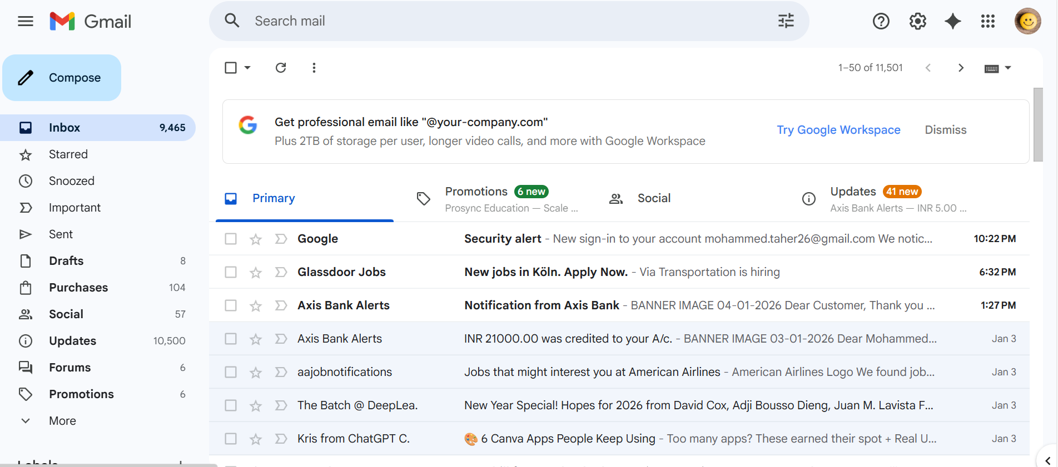
Gmail Front Page

Slide 4
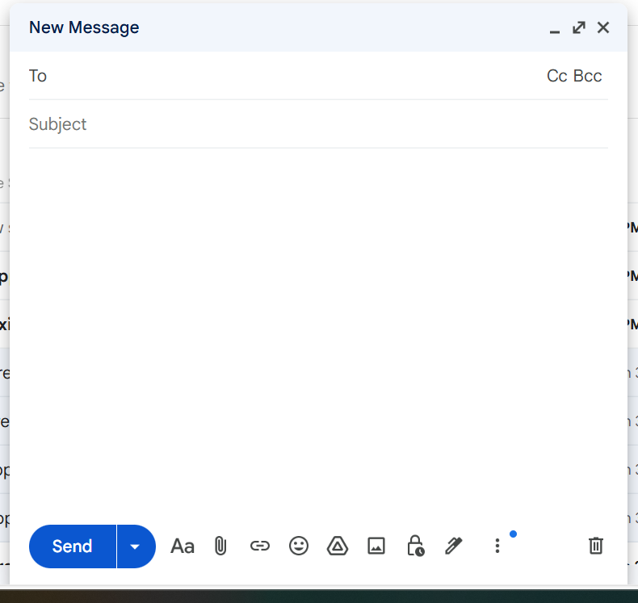
Inbox-Compose

Slide 5
THANK YOU

